Slide 1
DATA SCIENCE Liquidity Forecasting
Victor Pyanykh Shalev Levi Sagzan Instructor: Ofer Zevin

Slide 2
What we did Today
A reminderto what we trying to do: We try to develop A robust liquidity prediction model, and a model to predict if transaction will be executed or not. It is essential to proactively identify potential issues, safeguard market stability, and maintain operational continuity.
For that we ran models for each task below: Classification Task (Order is Executed or Not):
Machine Learning for Classification – XGBoost, Catboost, LightGBM
Deep Learning for Classification – LSTM, GRU
Forecasting Task (Liquidity Forecast):
*By using aggregation of 15 min for each lag and we try to predict the liquidity percentage for the next 15 min. Model used:
Machine Learning for Forecasting – XGBoost, Catboost, LightGBM. Used Tsfresh to get more features that will help not lose the time while aggregating the lags.
Deep Learning for Forecasting – LSTM, GRU, chronos-bolt-base (didn’t have time to test it yet).
We didn’t succeed yet to run ARIMA model today.

Slide 3
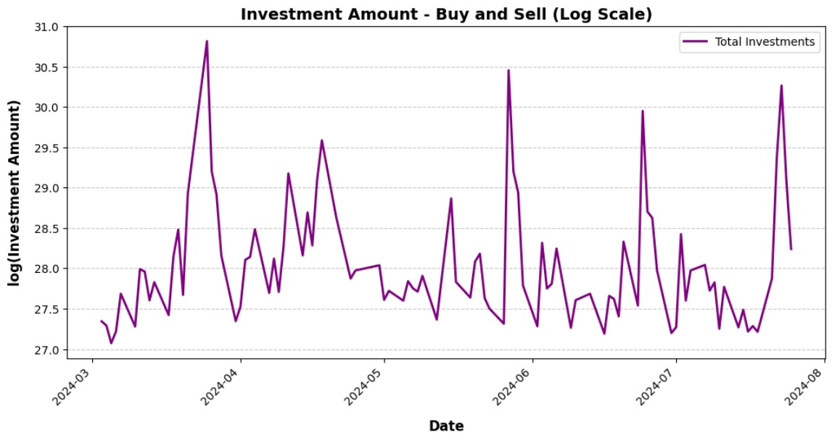
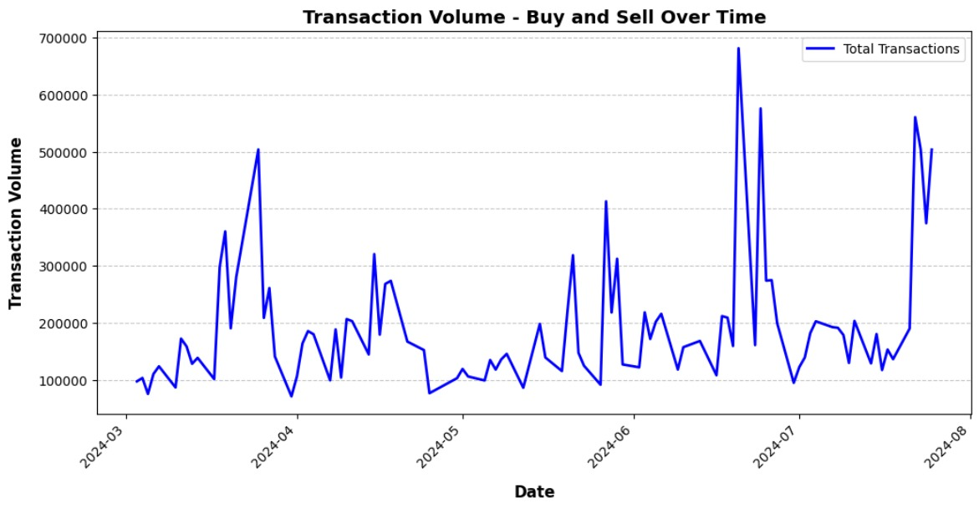
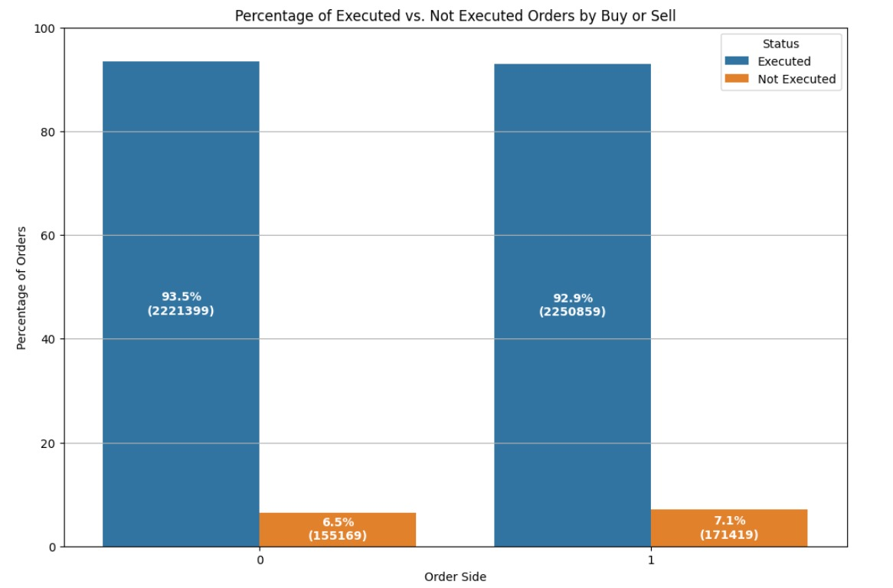
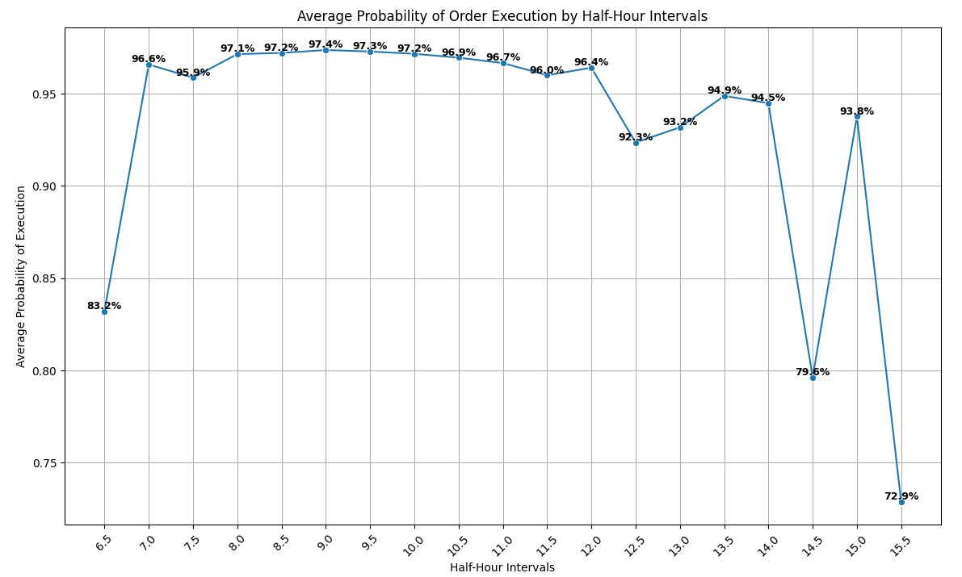
First Analysis

Slide 4
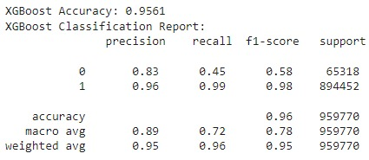
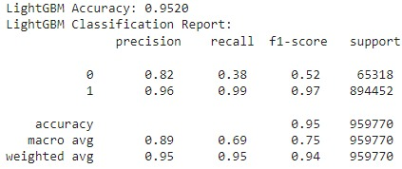
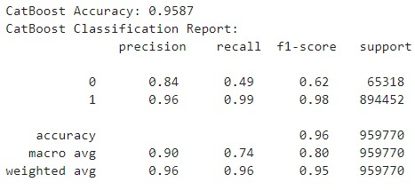
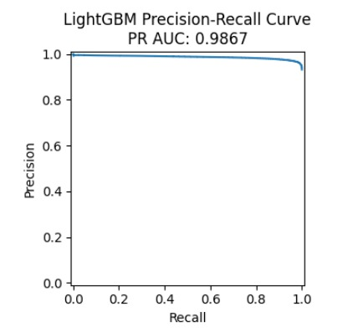
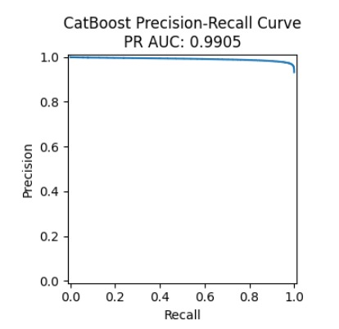
Machine Learning for Classification

Slide 5
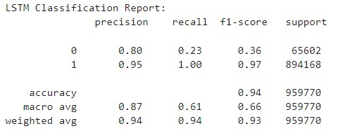
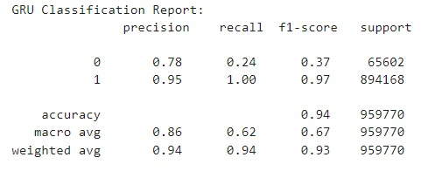
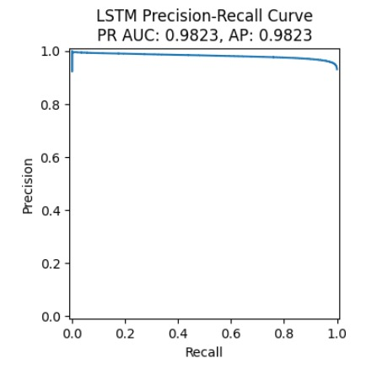
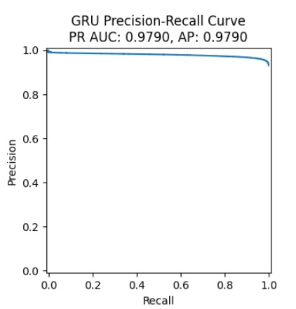
Deep Learning for Classification

Slide 6
Summerize
Model | XGBoost | LightGBM | Catboost | LSTM | GRU
PR AUC |  | 0.9867 | 0.9905 | 0.9823 | 0.9790

Slide 7



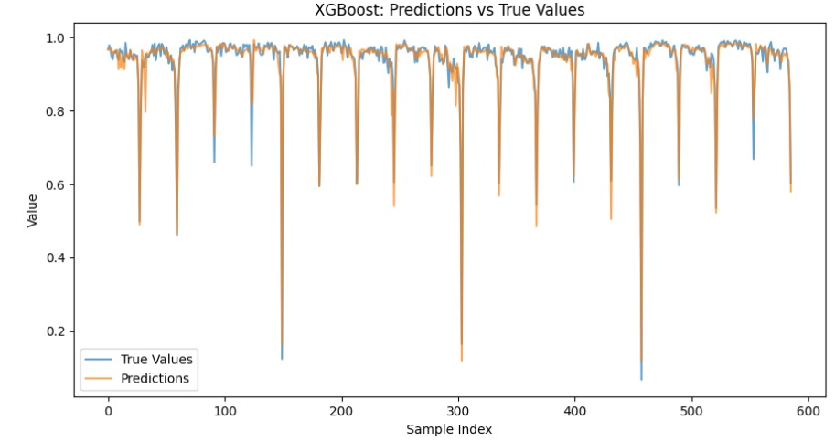
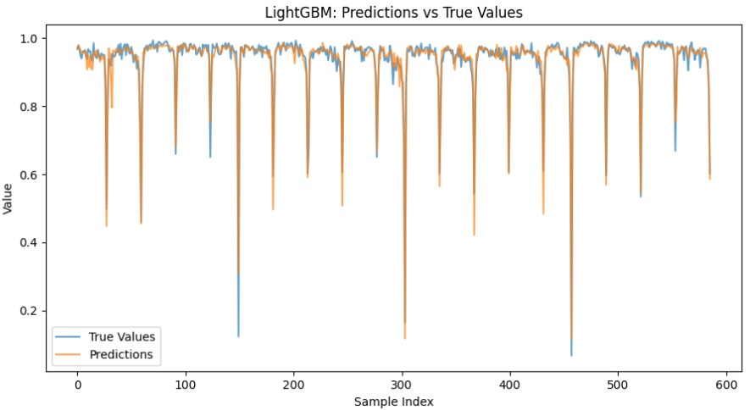
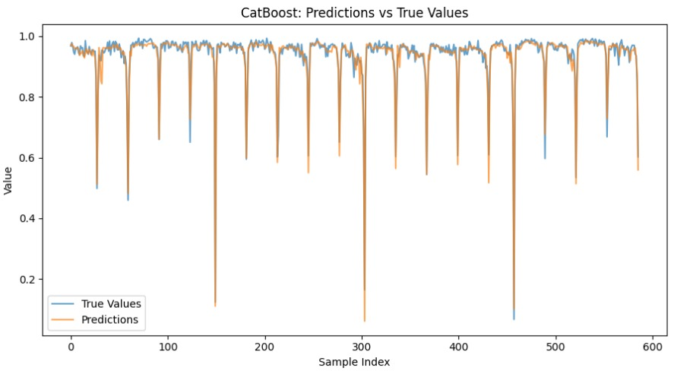
Machine Learning for Forecasting

Slide 8
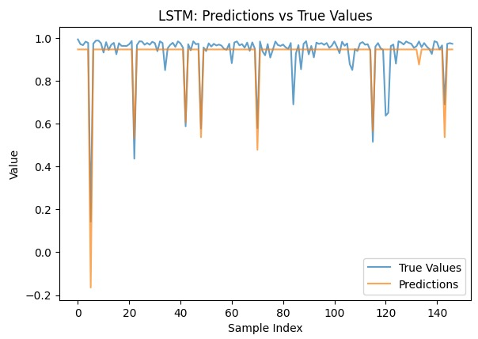
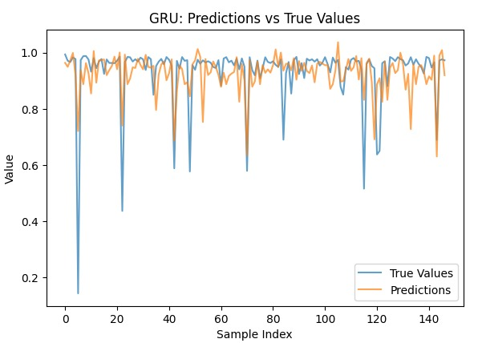
Deep Learning for Classification

Slide 9
Summerize
Model | XGBoost | LightGBM | Catboost | LSTM | GRU
MSE
MAE
R2

